Slide 1


K-Means
Clustering

Slide 2
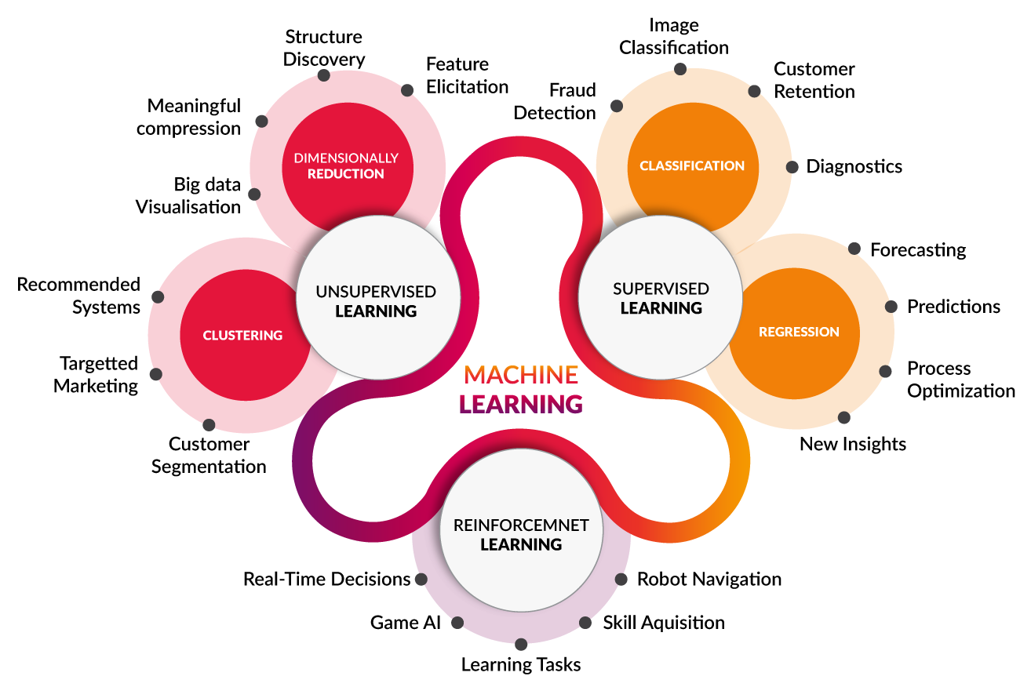
Machine Learning types

Slide 3
Unsupervised Learning usecases
Dimensionality Reduction => Compress datasets
Clustering => Divide data into meaningful groups

Slide 4
Supervised vs Unsupervised
Predict
VS
X1 | X2 | Y
x1 | x2 | y1
... | ... | ...
xn | xn | yn
X1 | X2 | Y
x1 | x2 | y1
... | ... | ...
xn | xn | yn

Slide 5
Supervised vs Unsupervised
CLUSTER 3
CLUSTER 2
CLUSTER 1
Supervised classification
Unsupervised Clustering

Slide 6
K-Means

Slide 7
K-Means Algorithm
The KMeans algorithm clusters data by trying to separate samples in n groups of equal variance, minimizing a criterion known as the inertia or within-cluster sum-of-squares
Source: Sklearn

Slide 8
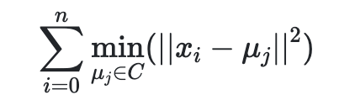
K-Means Algorithm
WCSS =
C = clusters
µ = mean within a given cluster
x = data point

Slide 9
Process
Initialize K clusters
Calculate centroids
Assign each data points
Get your K-clusters
1
2
3
4

Slide 10
Step 1 - Initialize K clusters
K = 3

Slide 11
Step 2 - Calculate centroïds

Slide 12
Step 3 - Assign data points to the closest centroid

Slide 13
Step 2 - Calculate centroids

Slide 14
Step 3 - Assign data points to the closest centroid

Slide 15
Step 2 - Calculate centroids

Slide 16
Step 3 - Assign data points to the closest centroid

Slide 17
Step 4 - Get our K clusters

Slide 18
How to get the optimal number K?

Slide 19
Two methods
Elbow => Check if data points within a cluster are close from their centroid
Silhouette => Check if clusters are far from each other

Slide 20
Elbow
WCSS = D( , ) + D( , ) + D( , )
Where D() is the square distance from each data point to its centroid.

Slide 21
Elbow - WCSS with 1 cluster
WCSS = D( , )
Where D() is the square distance from each data point to its centroid.

Slide 22
Elbow - WCSS with 3 clusters
WCSS = D( , ) + D( , ) + D( , )
Where D() is the square distance from each data point to its centroid.

Slide 23
Elbow - WCSS with 4 clusters
WCSS = D( , ) + D( , ) + D( , ) + D( , )
Where D() is the square distance from each data point to its centroid.

Slide 24
Elbow - WCSS with 4 clusters
WCSS
The more clusters we get the less different the inertia (WCSS) is going to be
# Clusters

Slide 25
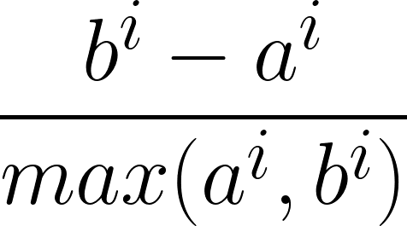
Silhouette
Where
a → average distance from all data points in the same cluster
b → average distance from all data points in the closest cluster

Slide 26
Silhouette
Close to 0 => Clusters are close from each other
Close to 1 => Clusters are far from each other

Slide 27

Thanks!
See you in the next course

